Slide 1
Module Development II
Adding services and data access objects

Slide 2
When and why?
If a module is going to add to the OpenMRS data model then it's important to create DAOs and services
Is consistent with the programming model used by the rest of OpenMRS
Gives OpenMRS core and other modules access to the functionality of the module
Even if a module doesn't have its own data, it might be appropriate to create a service for it
E.g. a module which analyzes existing data

Slide 3
How?
Modules can insert DAOs and services into the application context, in the same way that OpenMRS core does, e.g.
OpenMRS Application Context
OpenMRS Core
PatientDAO
PatientService
ConceptDAO
ConceptService
inserts
...
AppointmentsModule
AppointmentDAO
AppointmentService

Slide 4
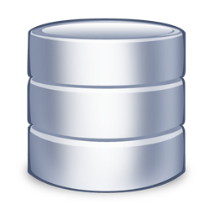
Adding to the database
We could use our module activator class to execute SQL to add new tables, however...
We would need to check the tables don't already exist
What if we want to make schema changes to our module's database tables?
AppointmentsModule

Slide 5
SqlDiff
A mechanism in OpenMRS for a module to manage versions of its database tables
A module includes a sqldiff.xml which tells OpenMRS...
How to create the tables for the module when its first installed
How to update the table schemas for newer versions of the module

Slide 6
Example (sqldiff.xml)
The version number of module's data model
<sqldiff version="1.0">
<diff>
<version>1.0</version>
<author>EHSDI</author>
<date>Sept 30th 2010</date>
<description></description>
<sql>
CREATE TABLE IF NOT EXISTS appointment (
appointment_id int(11) NOT NULL auto_increment,
patient_id int(11) default NULL,
provider_id int(11) default NULL,
location_id int(11) default NULL,
date date default NULL,
PRIMARY KEY (appointment_id)
) ENGINE=InnoDB DEFAULT CHARSET=utf8;
</sql>
</diff>
</sqldiff>
Helpful information for the a developer
SQL to be executed

Slide 7
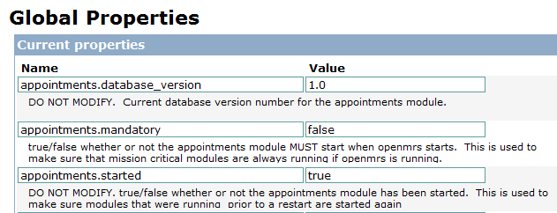
Example
When we install the module, OpenMRS runs the sqldif.xml file, which
Creates the table
Creates a global property which records what version of the module's data model is in the database, i.e.

Slide 8
Example
Now supposing we need to modify the data model. We need to...
Create a new version of the module's data model
Provide the SQL to get from the old version to the new
We can do this by creating a new <diff>
For example, if we want to add a TEXT field called reason to the appointments table...

Slide 9
Example (sqldiff.xml)
The old diff (1.0 ) remains unchanged
<sqldiff version="1.0">
<diff>
<version>1.0</version>
<author>EHSDI</author>
<date>Sept 30th 2010</date>
...
</diff>
<diff>
<version>1.1</version>
<author>EHSDI</author>
<date>Sept 31st 2010</date>
<description></description>
<sql>
ALTER TABLE appointment ADD reason TEXT DEFAULT NULL;
</sql>
</diff>
</sqldiff>
The new diff (1.1) makes the change to the schema

Slide 10
What happens...
If a user installs the module for the first time...
They won't have a global property called appointments.database_version, so OpenMRS will consider itself to be at version 0
OpenMRS will run all the diffs whose version is greater than 0
This is will...
Create the table (1.0)
Add the new field to the existing table (1.1)

Slide 11
What happens...
If a user has version 1.0 of the module, and updates to version 1.1
They will have a global property called appointments.database_version which tells OpenMRS that they have version 1.0
OpenMRS will run all the diffs whose version is greater than 1.0
This is will only...
Add the new field to the existing table (1.1)

Slide 12
Hibernate
We can also add Hibernate mapping files to map between our tables and our Java classes
These are added to the metadata folder
And then referenced in the module's config.xml, e.g.
<module configVersion="1.0">
...
<mappingFiles>
Appointment.hbm.xml
</mappingFiles>
</module>

Slide 13
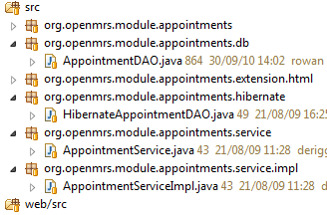
DAO and service
DAOs and services are added to the module like any other Spring application, e.g.
DAO interface
DAO implementation
Service interface
Service implementation

Slide 14
DAO and service
These then need to be added as beans like in a regular Spring application, e.g.
<bean id="appointmentDAO"
class="org.openmrs.module.appointments.hibernate.HibernateAppointmentDAO">
<property name="sessionFactory" ref="sessionFactory" />
</bean>
<bean id="appointmentService"
class="org.openmrs.module.appointments.service.impl.AppointmentServiceImpl">
<property name="appointmentDAO" ref="appointmentDAO" />
</bean>
Defined in OpenMRS's application context

Slide 15
DAO and service
Finally we need to register our service with OpenMRS so that it can be accessed like the other services, e.g.
This will...
Make it accessible from other modules or OpenMRS core
Allow it to use the transaction manager in OpenMRS core
Add support for the @Authorized annotation which is defined in OpenMRS
ServiceContext.getInstance().getService(AppointmentService.class)

Slide 16
DAO and service
Calls setModuleService()
Class name to associate this service with
<bean parent="serviceContext">
<property name="moduleService">
<list>
<value>org.openmrs.module.appointments.service.AppointmentService</value>
<bean
class="org.springframework.transaction.interceptor.TransactionProxyFactoryBean">
<property name="transactionManager" ref="transactionManager" />
<property name="target" ref="appointmentService" />
<property name="preInterceptors">
<list>
<ref bean="authorizationInterceptor" />
</list>
</property>
<property name="transactionAttributeSource">
<bean
class="org.springframework.transaction.annotation.AnnotationTransactionAttributeSource" />
</property>
</bean>
</list>
</property>
</bean>
The proxy for the service that supports transaction management

Slide 17
References
http://wiki.openmrs.org/display/docs/Creating+Modules

